Slide 1
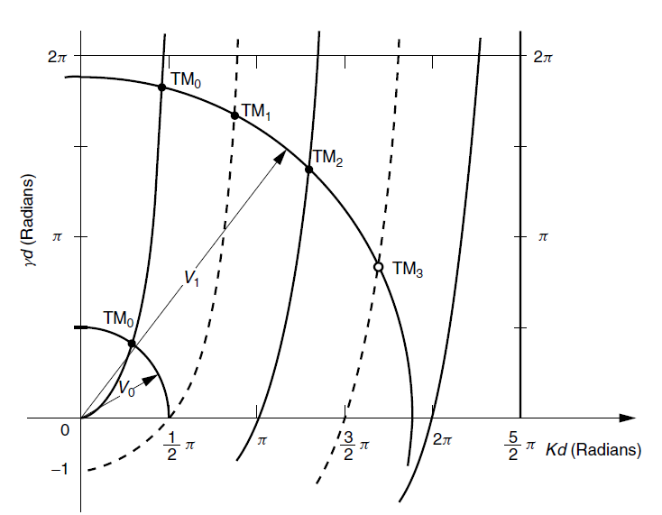
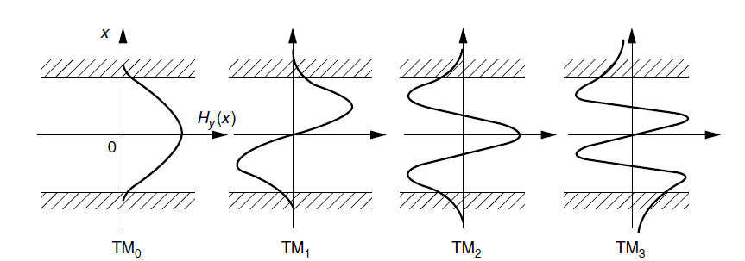
TM modes Field distributions
High order even modes →
More penetration depth of Evanescent field in Cladding

Slide 2

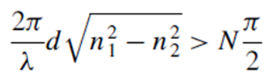
Example
A symmetric guide designed to be mono-mode for a wavelength of 1.3 μm was excited by a He–Ne laser. At most, how many TM modes will be excited by the He–Ne laser (0.63 μm) in this guide?
→ The total number of TM modes including the zero-order mode is N + 1

Slide 3
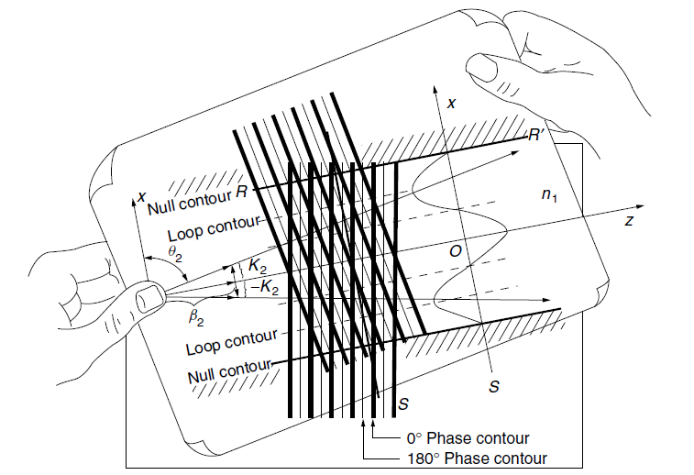
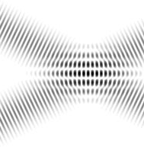
Decomposition in to two component plane waves
Interference of these two plane waves → field distribution of the mode.
This can be demonstrated by drawing lines on two sheets of transparent paper.

Slide 4
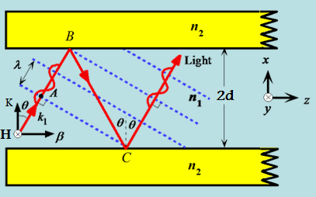
Decomposition in to two component plane waves
The boundary conditions are satisfied only for a discrete number of angles.
Phase matching condition is satisfied.

Slide 5
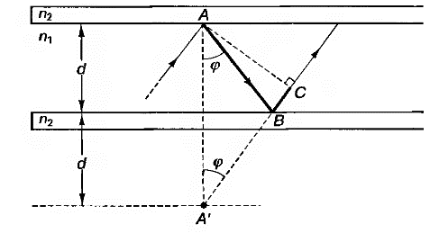
$$∆=AB+BC=A^{′}B+BC=4dn_{1}cosφ$$

Slide 6
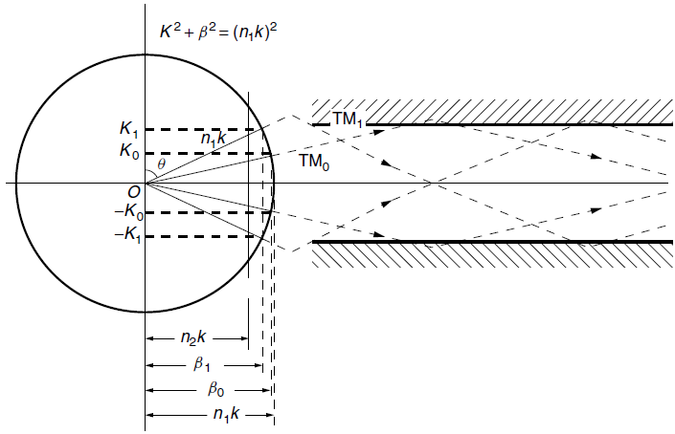



K-β circle
Field does not zero on the boundary → Evanescent wave → Inaccuracy in situating the null → Finding K and β → accuracy in situating
Critical Angle
The range of allowed values of β is limited

Slide 7
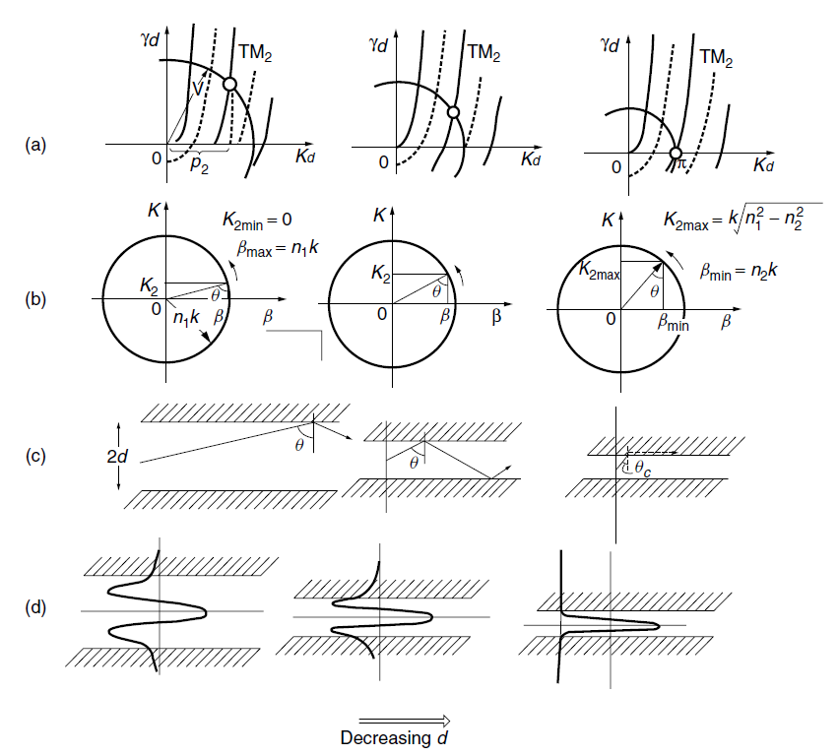

Changes to the parameters of the TM2 mode in a slab optical guide with respect to its core thickness
the decrease in p2 is much slower than the decrease in d itself
(keep in mind that V and d are linearly related) so that the value of K2 in fact increases
with a decrease in d.

Slide 8
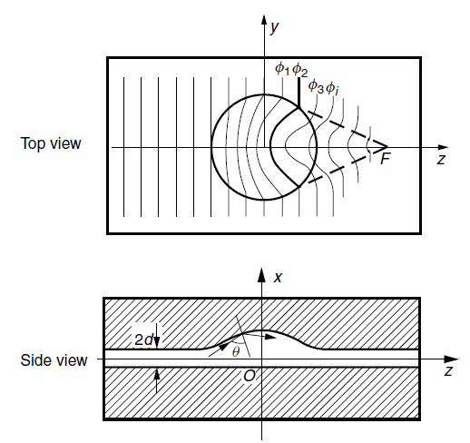






Effective index of refraction

Slide 9

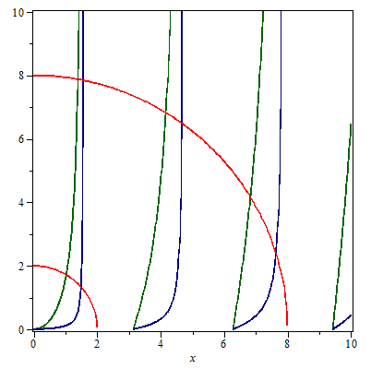


TE Modes
Even TM mode
Odd TM mode

Slide 10
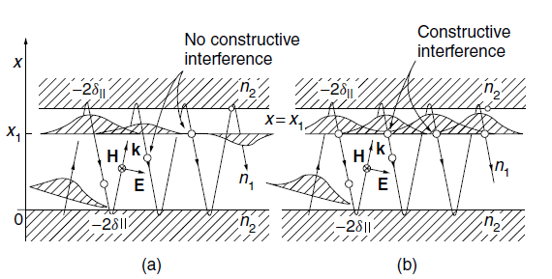




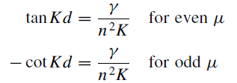

Modified Ray Model Method
(a) Random phase (b) In phase

Slide 11



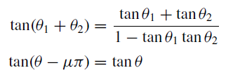
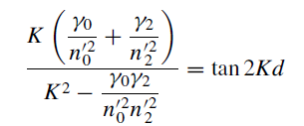
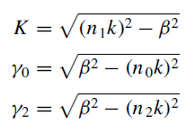
Asymmetric waveguide
n0
n1
n2

Slide 12
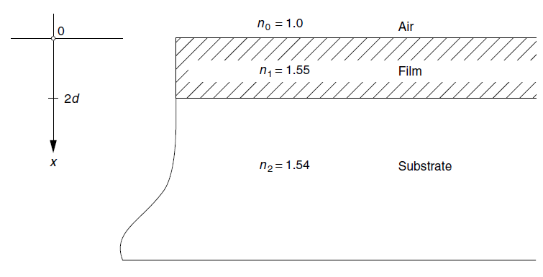
An asymmetric optical guide
(a) The total number of possible modes.
(b) The conditions for a single mode guide.
(c) The field distributions for the first few mode orders.
(d) The correlation of the region of β with the field pattern and directions of propagation of the component plane waves.
If the condition of total internal reflection for the film–substrate is satisfied, that for the air–film is automatically satisfied. Results are determined by the film–substrate boundary

Slide 13
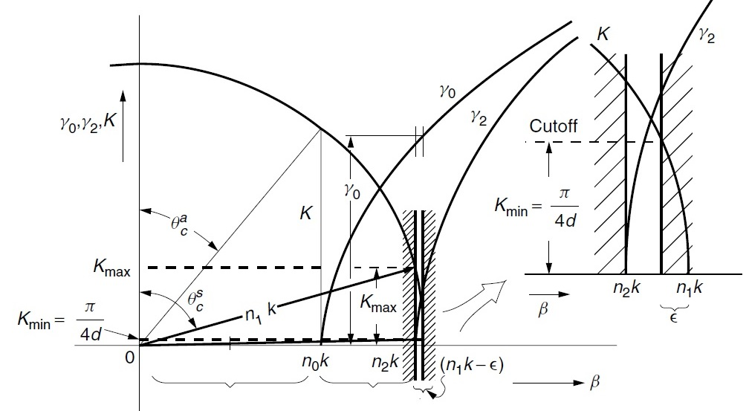
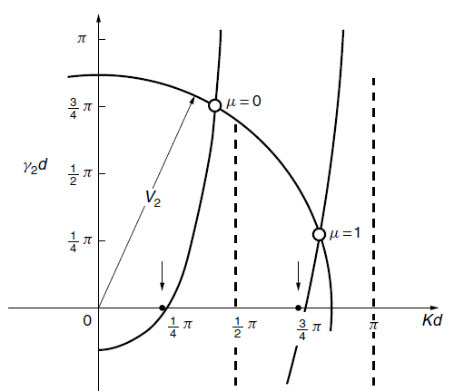
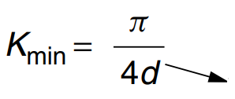
First, the region of β:
Range of β where mode propagation takes place is so narrow

Slide 14


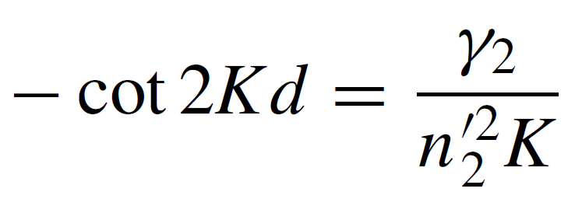
Next, an approximate expression for the Characteristic Equation
The range of β is so narrow
The value of ˠ0 can be assumed constant over this range
ˠ0 in this region is much larger than Kmax.
Hence, the value ranges from 70° to 90° depending on the value of K.
For simplicity is assumed .
With this assumption, Ch. Eq. is simplified:

Slide 15
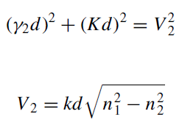

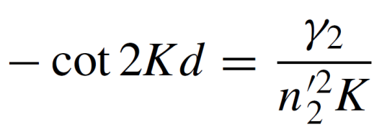
(a) The total number of possible modes:
The change in the index of refraction at the air–film interface is much greater than that at the film–substrate interface. Therefore, if the condition of total internal reflection for the film–substrate is satisfied, that for the air–film is automatically satisfied. Hence, the results are primarily determined by the film–substrate boundary.
starting with V2 =π /4,
μ th mode are excited if
Mode Existence
Be single Mode condition

Slide 16

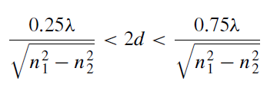
(b) The conditions for a single mode guide.
thickness 2d of the film has to satisfy:
An important feature of the asymmetric guide is that, unlike the symmetric guide,
The lowest order mode does have a cutoff and this cutoff occurs near V2 = π/4.

Slide 17
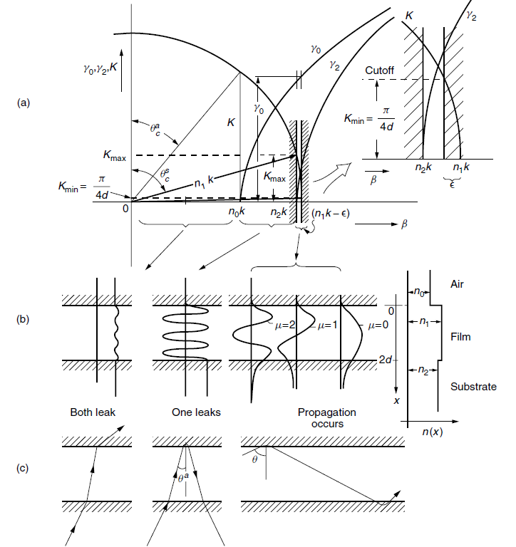

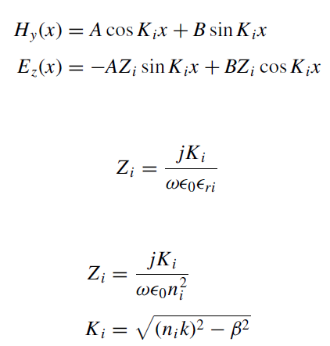
(c) The field distributions for the first few mode orders.
Evanescent Field
In Substrate & Cladding

Slide 18



(d) The correlation of the region of β with the field pattern and directions of propagation of the component plane waves.
Total internal reflection does not take place at either interface and the light ray penetrates these boundaries according to the usual laws of reflection and refraction at boundaries.
Total internal reflection does not take place at the film–substrate interface, but the light is totally internally reflected at the air–film interface.
Guided modes exist.

